Slide 1
Lecture 05 Fall 2016 Floats and start Linked Lists Homework: Float worksheet zyBooks: 4.1-4.8 and 7.1-7.4 Due next Friday.

Slide 2
Review binary worksheet

Slide 3
Signed representation: Bias-127 form Used for floating-point numbers
Signed integer | Internal form (biased)
128 | 255 = 11111111
127 | 254 = 11111110
…
1 | 128 = 10000000
0 | 127 = 01111111
-1 | 126 = 01111110
-2 | 125 = 01111101
…
-127 | 0

Slide 4
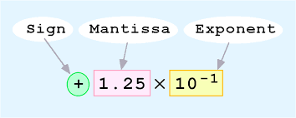
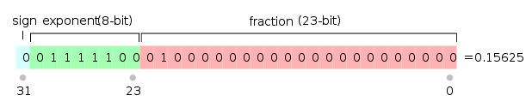
Floating-point: Many different ideas rolled into one!
=0.125 x 10^1
=0.0125 x 10^2

Slide 5
Real (floating point) Data

Slide 6
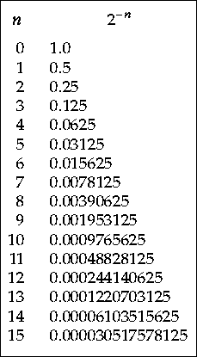
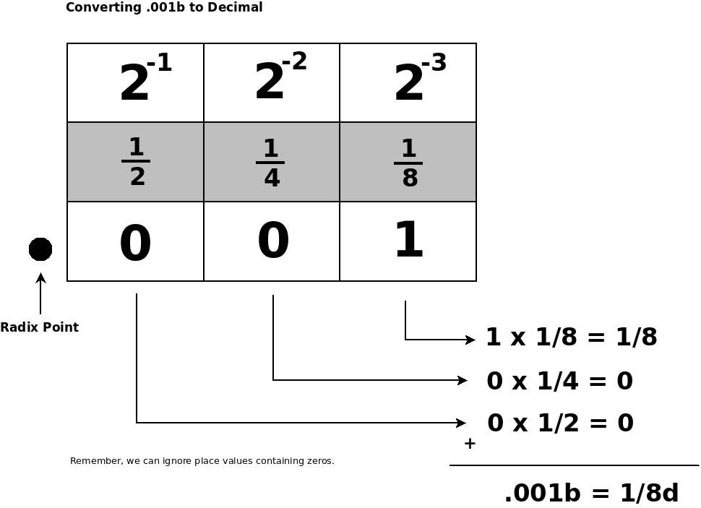
Binary Fractions

Slide 7
Problems with Real Representation

Slide 8
Linked Lists Part 1 Lecture 05 Fall 2016 Note: zyBooks uses -> notation but Java uses . (dot) notation EX: list.head = newNode;

Slide 9
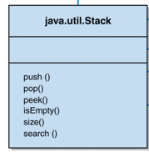
The java.util.Stack Class
The Java Collections framework defines a Stack class with similar operations
It is derived from the Vector class and therefore has some characteristics that are not appropriate for a pure stack.

Slide 10
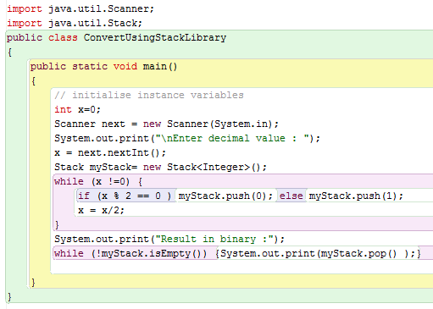

Slide 11

References as Links

Slide 12
Self-Referential Objects: Nodes
A Person object, for instance, could contain a reference variable to another Person object:
public class Person
{
private String name;
private String address;
private Person next; // a link to another Person object
// whatever else
}

Slide 13
Linked Lists
This type of reference can be used to form a linked list, in which one object refers to the next, which refers to the next, etc.
Each object in a list is often generically called a node
A linked list is a dynamic data structure in that its size grows and shrinks as needed, unlike an array, whose size is static or fixed
Java objects (Nodes) are created dynamically when they are instantiated using the new operator

Slide 14
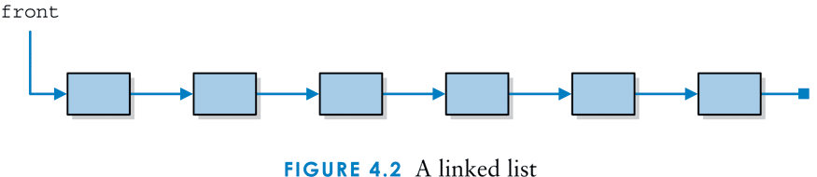
A linked list: Note front reference variable and NULL pointer at end.

Slide 15
Managing Linked Lists
The references in a linked list must be carefully managed to maintain the integrity of the structure
Special care must be taken to ensure that the entry point into the list is maintained properly
The order in which certain steps are taken is important
Check for inserting and deleting nodes in various positions (cases) within the list:
Front, Middle, End.

Slide 16
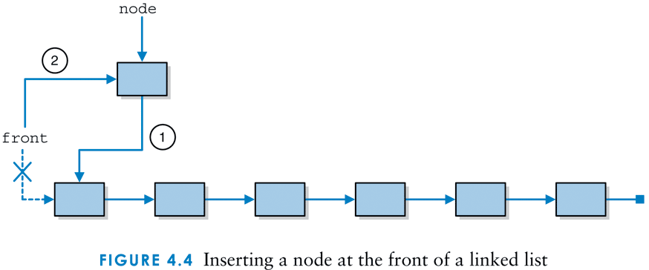
Add(1, newNode): Inserting a node at the front of a linked list. front is a reference pointer, not a node itself.
node.next = front;
front = node;

Slide 17
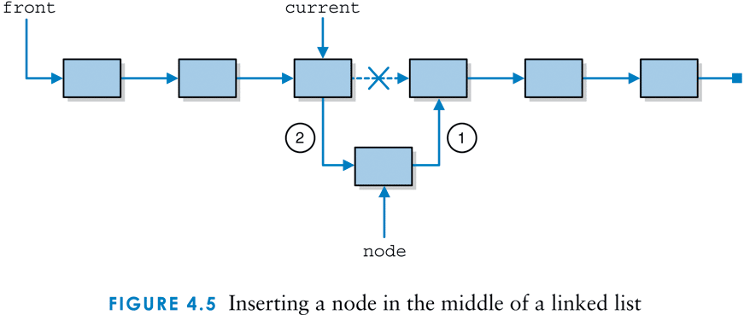
Add(4, newNode): Inserting a node in the middle of a linked list
node.next = current.next
current.next = node;
The dot operator can be used to traverse links:
front.next.next points to same object that current does!

Slide 18
Add(7, newNode): What about inserting a node at the END of a linked list? What is different?
node.next = null;
current.next = node;

Slide 19
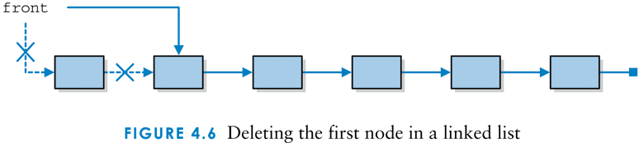
Remove(1): Deleting the first node in a linked list
front = front.next;

Slide 20
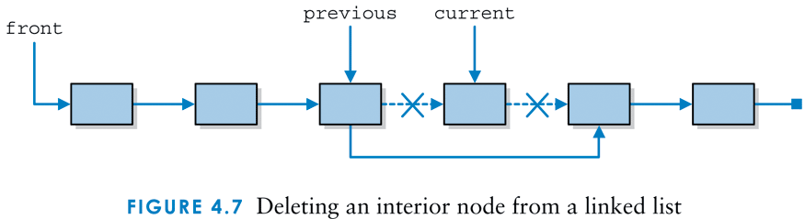
Remove(4): Deleting an interior node from a linked list
previous.next = current.next;
current.next=null;

Slide 21
Remove(6): How would we delete the end node?
previous.next = null;

Slide 22

Java Garbage Collection
Integer name = new Integer(4);
name = new Integer(50);
Old memory space reclaimed
Did this happen in Lab 2 ?

